Slide 1
Sean Joseph
Stundent number-10008782

Slide 2
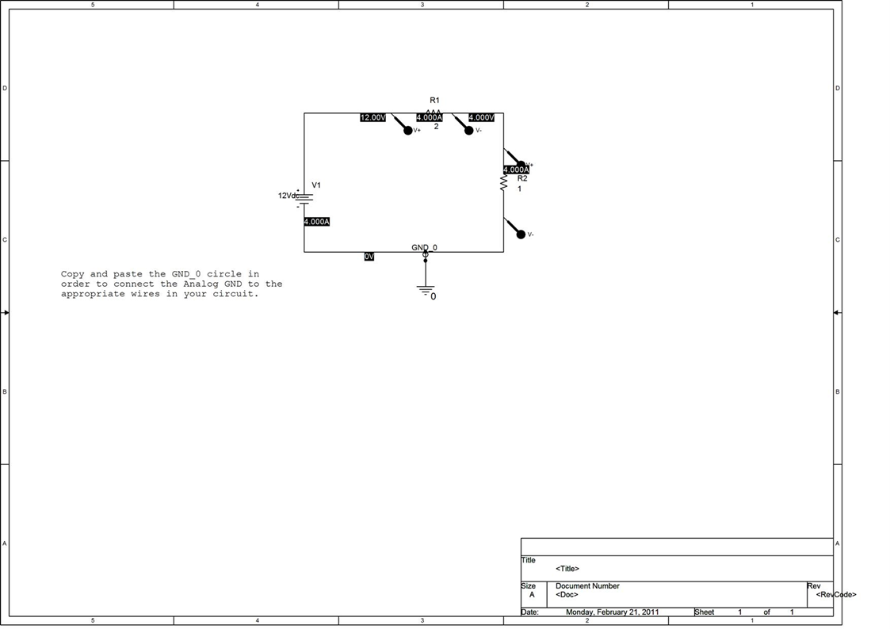
Question 1

Slide 3
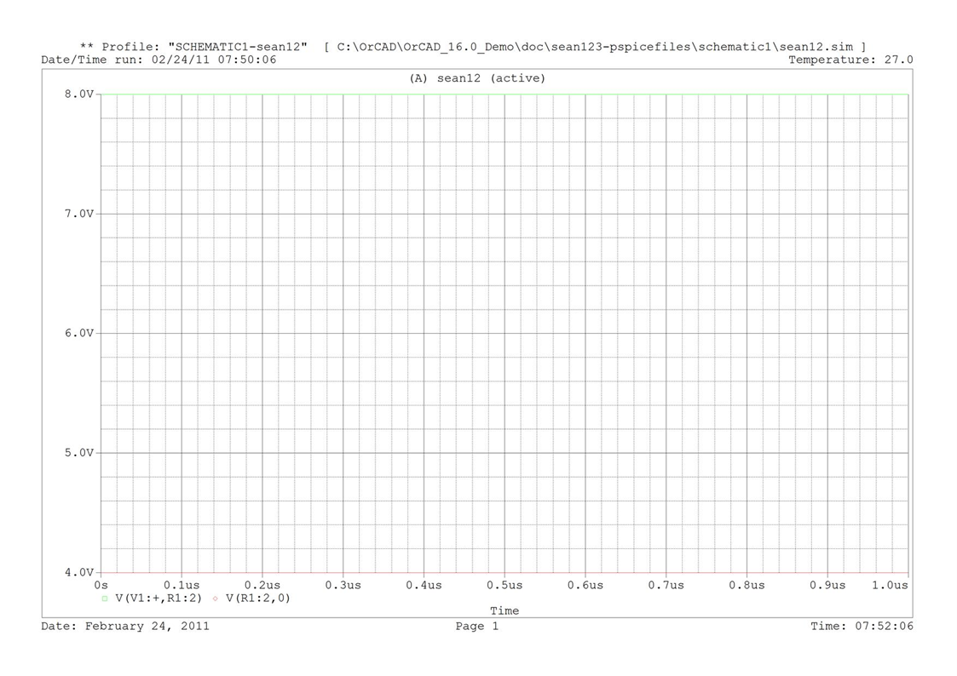
Time domain simulation of figure 1

Slide 4
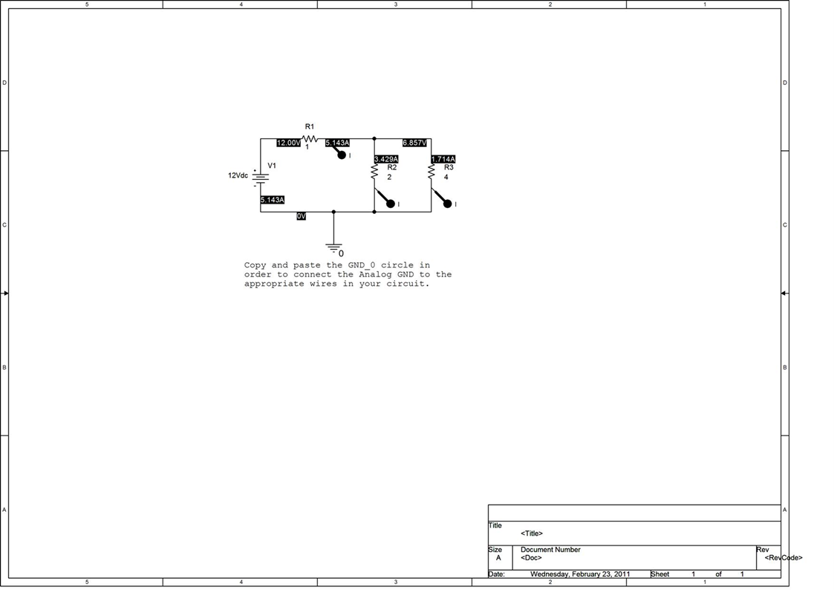
Question 2.1

Slide 5
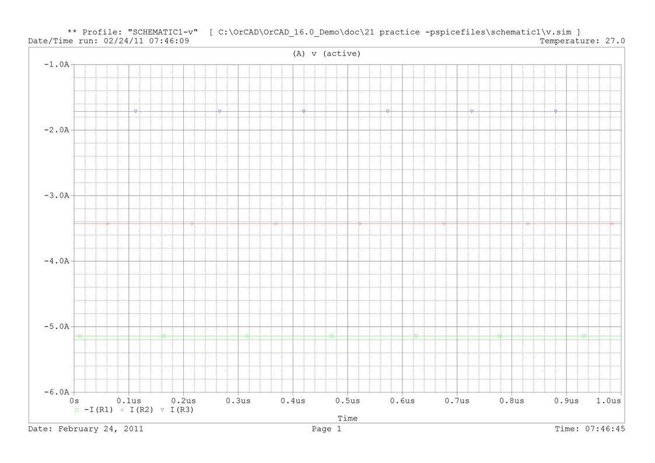
Time domain simulation for figure 2

